Slide 1
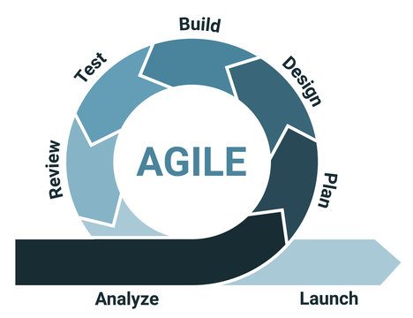
SNHU Travel Project
Joshua Reyes
CS 250
2/22/2026

Slide 2
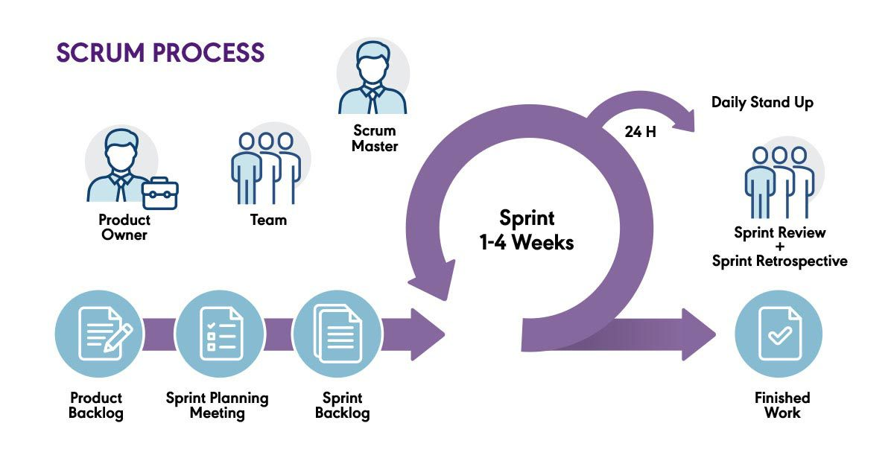
Agile & Scrum Overview
Agile focuses on flexible and step-by-step development
Work is done in small pieces called sprints
Feedback is used to improve the product over time
Scrum provides roles, events, and structure for Agile teams
Features are delivered gradually instead of all at once

Slide 3
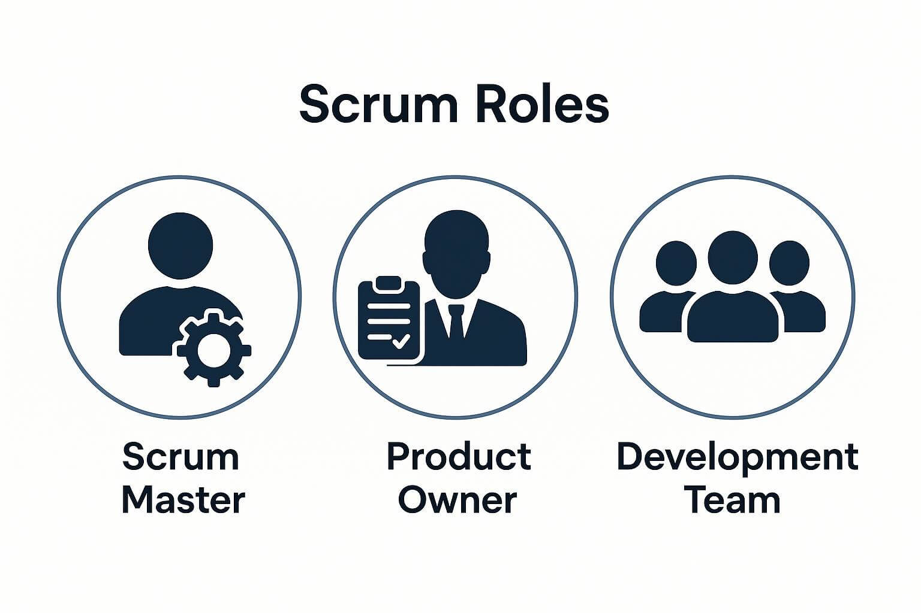
Scrum Roles
Product Owner writes and prioritizes user stories
Scrum Master keeps the team organized and on track
Developers build features during each sprint
Testers check that features work correctly
All roles work together to complete the product

Slide 4
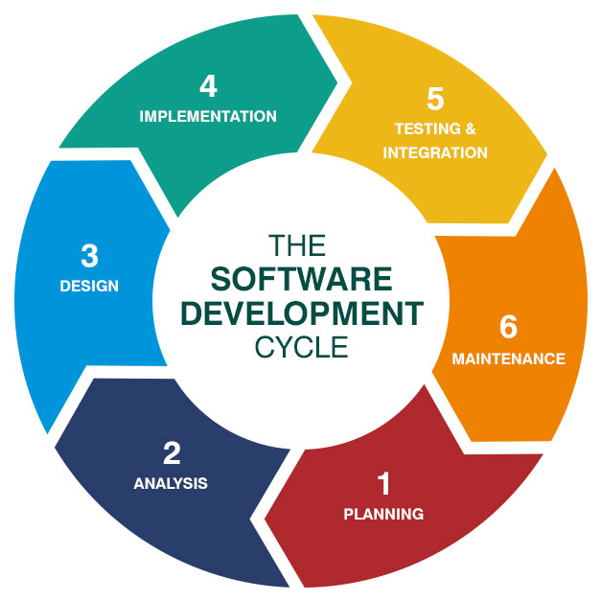
Agile Phases
Planning: define goals and create user stories
Design: decide how features will be built
Development: build features in short sprints
Testing: check for errors and fix issues
Review: look at progress and plan improvements

Slide 5
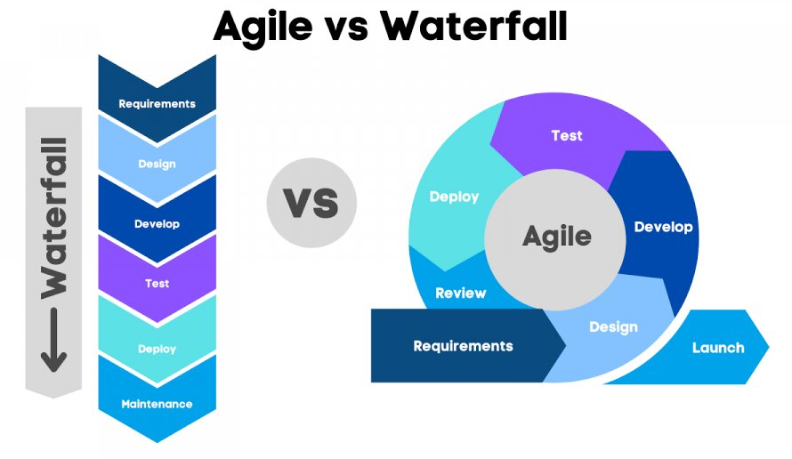
Waterfall Model Comparison
Waterfall follows a strict step-by-step process
Requirements are decided at the start
Changes are hard to make later in the project
Agile allows changes during development
Agile delivers working features in smaller steps

Slide 6
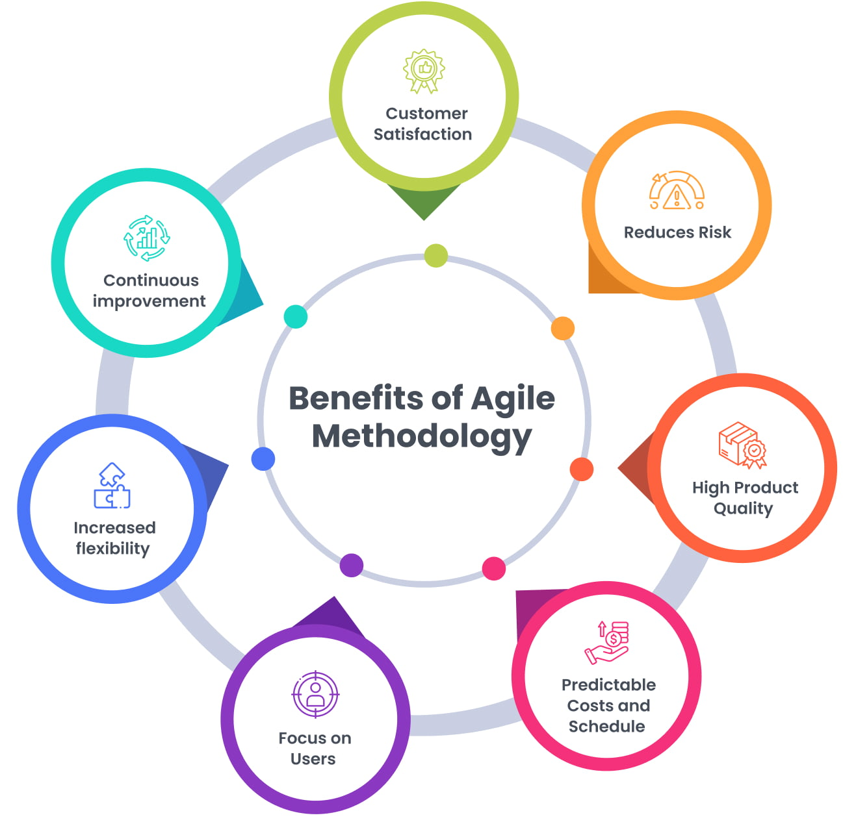
Why Agile Was the Better Choice
Helped build the ListView feature step by step
Made it easy to adjust user stories and priorities
Allowed steady progress during each sprint
Kept tasks organized and clear
Agile was effective for completing the project
Better supported changing requirements during development

Slide 7
References
Grebić, B., & Stojanović, A. (2021). Application of the Scrum Framework on Projects in It Sector. European Project Management Journal, 11(2), 37–46. https://doi.org/10.18485/epmj.2021.11.2.4
Askarpour, M., Kokaly, S., & S, R. (2024). An Exploration of Agile Methods in the Automotive Industry: Benefits, Challenges and Opportunities.
Widyantoro, A., Al Bina, F. F., Prayoga, T., Safei, R., & Arrasid, M. A. (2025). Systematic Literature Review: Membandingkan Pendekatan Metode Agile dan Waterfall dalam Pengembangan Perangkat Lunak. Journal of Comprehensive Science (JCS), 4(1), 183–193. https://doi.org/10.59188/jcs.v4i1.2969
Lim, M., Skelton, L., & Mehdipour, F. (2025). Bridging Agile and Traditional Practices: The Role of Project Managers in Enhancing Scrum Team Success and Sustainable Development (Vol. 2). Atlantis Press International BV. https://doi.org/10.2991/978-94-6463-720-5_11

